Slide 1

Tableau Project - Canadian Open data portal
Vanessa Little

Slide 2


Introduction
I chose option 1 for this project which involved reviewing data from the Canadian Open Data Portal. Using this information, I was able to analyze and determine different trends that I will be sharing with you.
Weekly earnings from 1.1.2001 to 15.4.2015 (weekly_earnings - CSV)
Housing constructions from 1955 to 2019 (real_estate_numbers - CSV)
House prices from 1.1.2005 to 1.9.2020 (real_estate_prices - EXCEL)
Housing_price_index from November 1979 to September 2020
Office_realestate_index from November 1979 to September 2020
Consumer index from November 1979 to September 2020

Slide 3
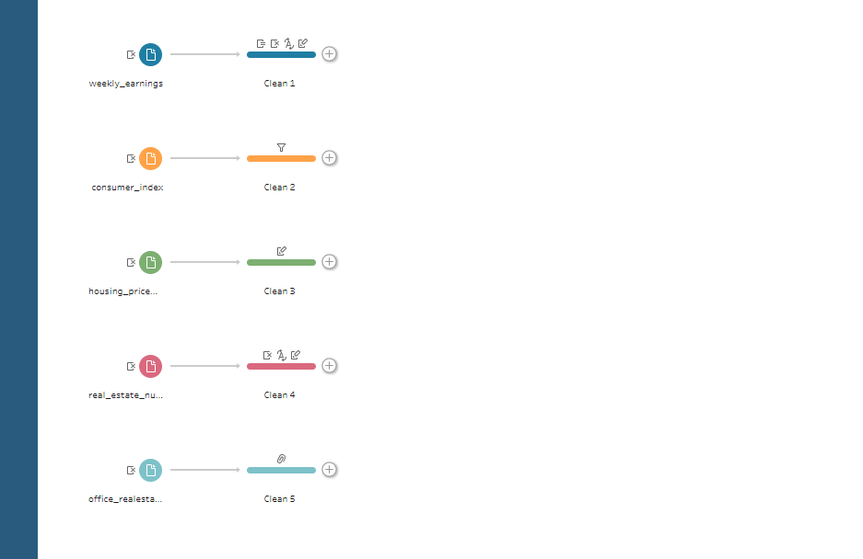
Step 1 –Parse & Clean Data

Slide 4
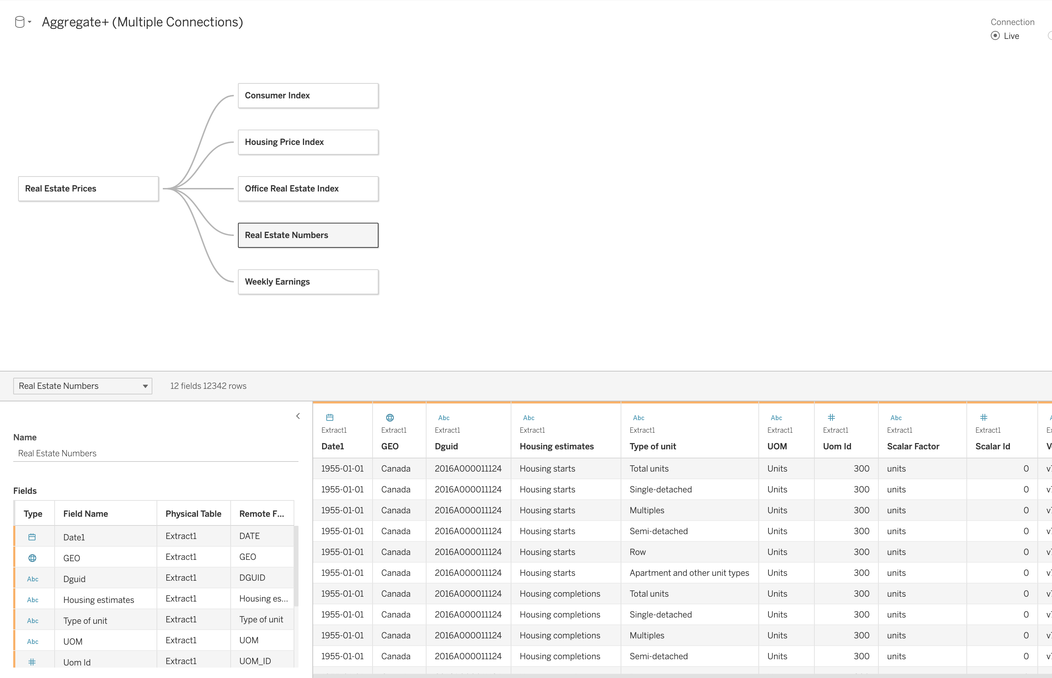
Step 2 –Connect to the data

Slide 5
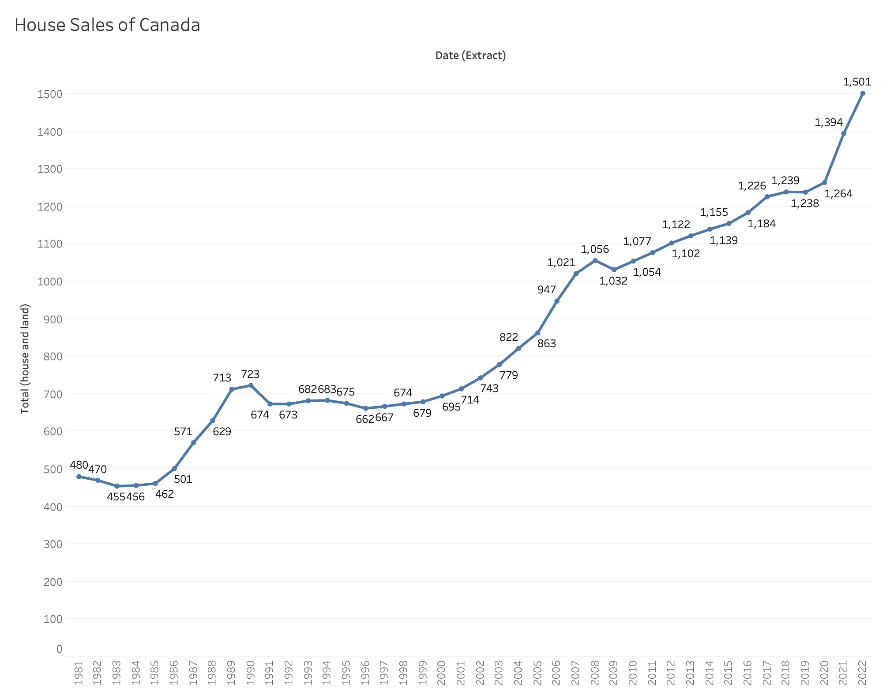
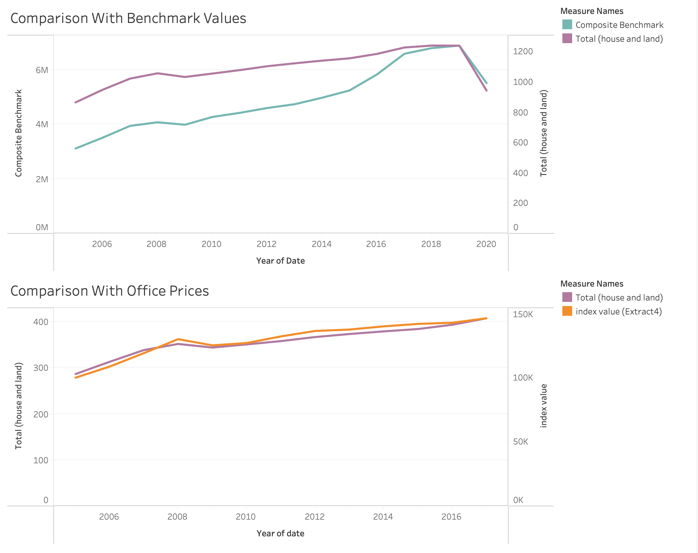
Dashboard 1
Dashboard 2

Slide 6
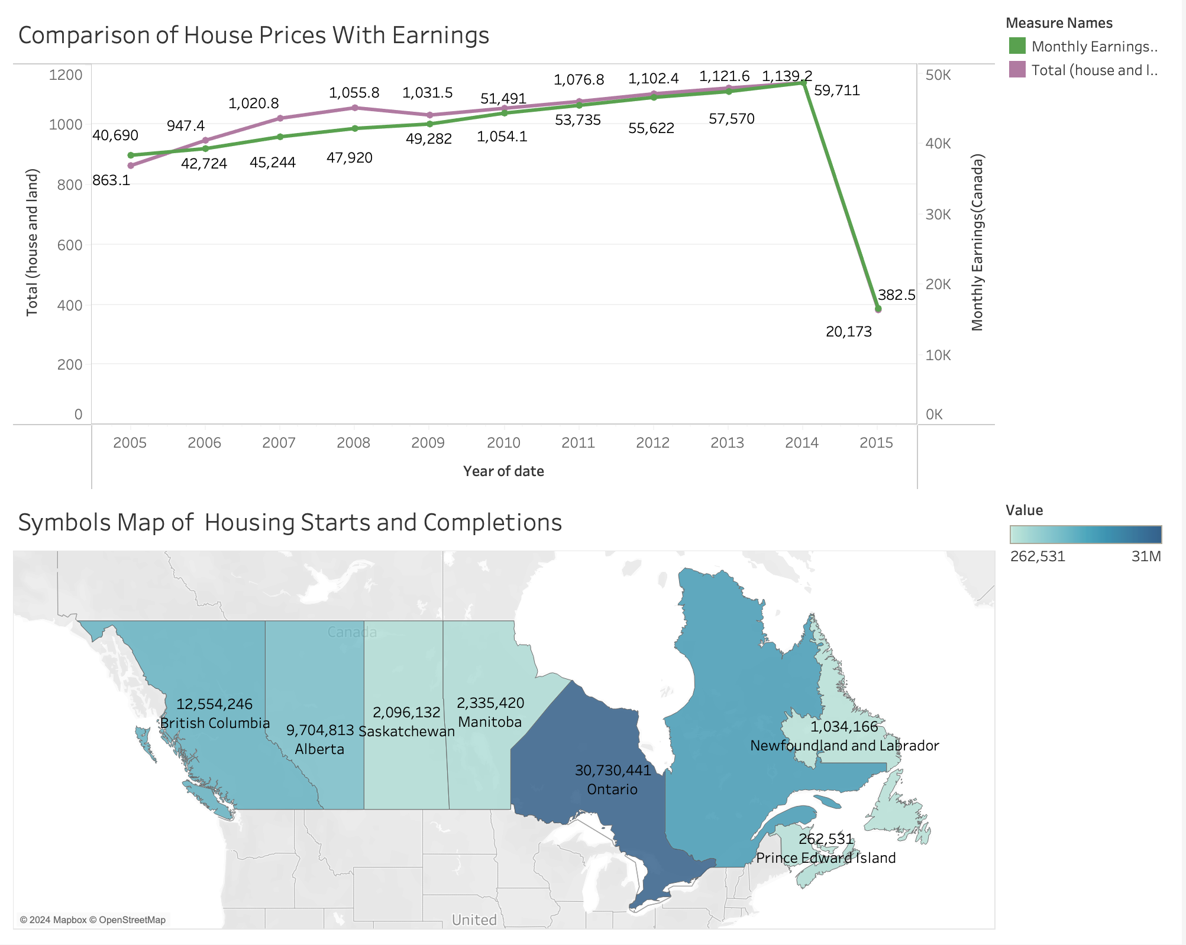
Dashboard 3

Slide 7




Challenges & future goals
Spend more time with the data to become more familiar with it
Access current data to compare against
Learn more about Tableau to create a more diverse range of visualizations
Become a Tableau expert

Slide 8

Thank you

